Slide 1
What I learned at
CAMP
> Learning DEV
Rachael Sweeten rachael.sweeten@gmail.com

Slide 2
Learning DevCamp 2015

Slide 3
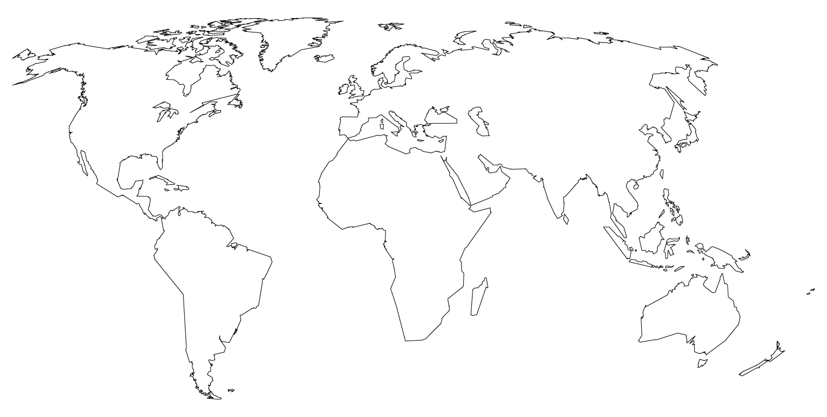
Convenient (But not Cheap.)
SLC
Notes:
Blue dots are distant places I have travelled: Peruvian Amazon, Tunisia, Egypt, Barcelona, Majorca, Sicily, Naples, Rome, Provence, Paris. Very little technology learning occurred in any of these places, except SLC.

Slide 4
$999.00
16 chances
100%
That’s a lot of money.
to get your money’s worth.
Overwhelming!

Slide 5
My Main Points:
Technology
Stories
Graphic Arts
How did I get here?

Slide 6
Technology & Multimedia
Varied
Competitive
Never-ending new releases
Captivate
Articulate, Lectora
PDF editable, .ppt
Notes:
The importance of an LMS seems to be known, but it doesn’t stop professional in the corporate sector from reinventing their own, and repurposing older technologies, like editable .pdfs and PowerPoints.

Slide 7
STORIES!
“Stories activate more of the brain.”
-Katie Stroud, Incremental Success

Slide 8
To make learning stick:
Take learning content and turn it into a story.
Solve a problem.
Address “suffering” & add heart.
Notes:
The linguistic [word] part of the brain turns words into symbols. Stories activate more parts of the brain, and the brain fills in story components naturally, when activated.
“If you don’t address suffering, you are not addressing the problem. “-Katie Stroud. This is the basis of her business: personalizing the story and getting emotional investment from learners.

Slide 9
Great stories:
Start with the best part.
Get exciting right away!
Show the resolution.
Notes:
Resolution= What the world looks like when people are doing something right. Show the resolution! Resolution is inspiration for learners.
Starting with the climax of the story tends to: get attention, keep listeners from tuning out or being bored.

Slide 10
Catch Phrases:
“Look for little ways
to make a
big impact.”

Slide 11
“Connect, Communicate, Collaborate.”
-J.O’Connell and D. Groom

Slide 12
Where the magic happens.
YES!
Boredom
Distress

Slide 13
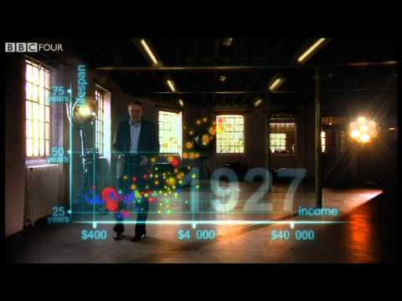
Hans Rosling Video
Compresses weeks worth of statistical learning into <5 minutes, and stays interesting.
Notes:
https://www.youtube.com/watch?t=34&v=jbkSRLYSojo “200 COuntries, over 200 years” Global health and wealth statistics. Great followup video for another time: https://www.youtube.com/watch?v=hVimVzgtD6w
Great example of videos for learning and retention. Despite his accent and high vocal tone, the details are shared brilliantly. *Try the KWL diagram with listeners: Prove the learning retention from this video.

Slide 14
Graphic Arts “Gestalt”
Any questions?
Yes. What does Gestalt mean?
http://graphicdesign.spokanefalls.edu/tutorials/process/gestaltprinciples/gestaltprinc.htm
Notes:
ge·stalt ɡəˈSHtält,-ˈSHtôlt/ noun PSYCHOLOGY 1. an organized whole that is perceived as more than the sum of its parts.
Law of [Automatic] Closure=the mind fills in partial graphics while freeing space for content.
Law of Continuity=Human Brain visually continues a pattern, even when we don’t see it end.
Law of Similarity=Group like things by like things, even representing common changes, such as changing font size and color.
Law of Figure & Ground=Shapes in conjunction become recognized as something new. The eye perceives a figure as distinct from a background.
Law of Proximity= Spacing and movement conveys grouping and relationships, or breaks it. Can also turn repeating shapes into a new pattern.

Slide 15
The C.R.A.P. Plan
Contrast
Repetition
Alignment
Proximity
Notes:
Contrast: Can you read without this? Nope. Opposite values help with attention and readability.
Repetition: Styles Guides help with size, shape, color, color-family hues, complementary, monochrome.
Alignment: Structure and organization within design.
Proximity: What item is by what item? Put words by the picture to which they belong, for clarity.

Slide 16
Want big impact?
Use big image.

Slide 17
To serif,
or not to serif...
Serif
Best for paper print.
Helps low literacy readers.
Sans Serif
Best for screens.
Best for skilled readers.
Helvetica

Slide 18
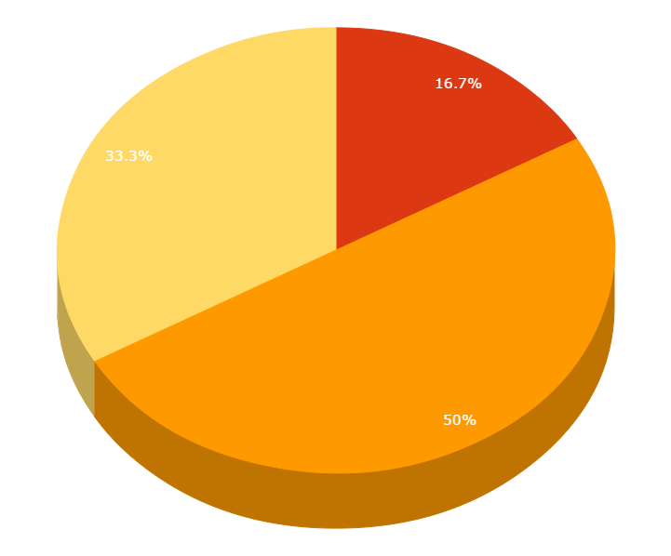
Best Guess of Attendee Demographics*
IDET Students
Educators
Industry and Corporate trainers
Notes:
*Complete invention of Rachael Sweeten.

Slide 19
Our process is easy
Objectives
Objectives Achieved
*Miracle
*ADDIE, Flipped Classroom, Student Centered Learning, PBL, CBE, Fab ID Team, etc.

Slide 20
To SCORM,
or not to SCORM ...
This event underscored for me the need for an organizing system, SCORM compliant.
I reopened the old issue and presented updated Canvas directions to the Canvas Administrator, to enable SCORM LTI at account level for Canvas.
We’re cutting edge!
Notes:
*With Maryanne activating at admin level and Kathy testing with a Captivate file in Beta, and I forwarded a friendly Bridge Marketing idea to Instructure: The corporate side seems ripe for an organizing tool, as each designer seems to reinvent the wheel in order to showcase their pet software choice.
* This SCORM improvement allows SLCC and Canvas to encourage and house the multimedia creations of motivated Faculty!

Slide 21
Fin
Notes:
All notes and observation belong to the Author Rachael Sweeten, and may not reflect the opinions and values of original presenters.

